Slide 1
DECO2300/DECO7230 Week 7 Tutorial
Testing and Analysis

Slide 2
IN THIS TUTORIAL
Test your prototype and collect data for analysis
Collect Quantitative data via script in Unity
Simple Visualisation/Interpretation/Analysis of data
Work on prototype II

Slide 3
Horizontal vs Vertical Prototype (From Week 5 Lecture)
Horizontal
Models many features with little detail
Horizontal slice of a system's structure chart from top to specific depth
Test overall interaction metaphor
Vertical
Models few features with high detail (DECO2300/7230)
Vertical slice of system structure chart Test details of the design
http://csweb.cs.bgsu.edu/maner/domains/Proto.htm

Slide 4
Vertical (From Week 5 lecture)
Focused on testing functionality
Separate to the rest of the system
Example: testing the shake to cancel functionality. Implement reading the shake, measuring the shake (discerning it as a deliberate shake)
Narrow in on particular, potentially difficult/problematic components (ie. a tech spike)

Slide 5
Formulating Useful Questions (From Week 5 Lecture)
3 main types of study
Comparison
Survey, focus group, A/B testing
Attitude
Desirability study, participatory design, context mapping, conjoint analysis, interview/focus group
Behaviour measuring
Field study/Site Visit, Prototype study, Heuristic Evaluation/Cognitive Walkthrough, Eye tracking, Data Mining/Analytics
http://www.questionablemethods.com/2011/11/work-backwards-to-create-good-research.html

Slide 6
Designing Questions (From Week 5 Lecture)
Techniques depending on the type of response being gathered:
Qualitative
Deals with descriptions - can be observed but not measured
Understand underlying reasons Unstructured or semi-structured techniques
Quantitative
Deals with numbers - measure magnitude
Structured techniques
(Today we will cover how this can be collected in Unity)
Interaction Design :Beyond Human-Computer Interaction. Preece, Rodgers & Sharp.

Slide 7
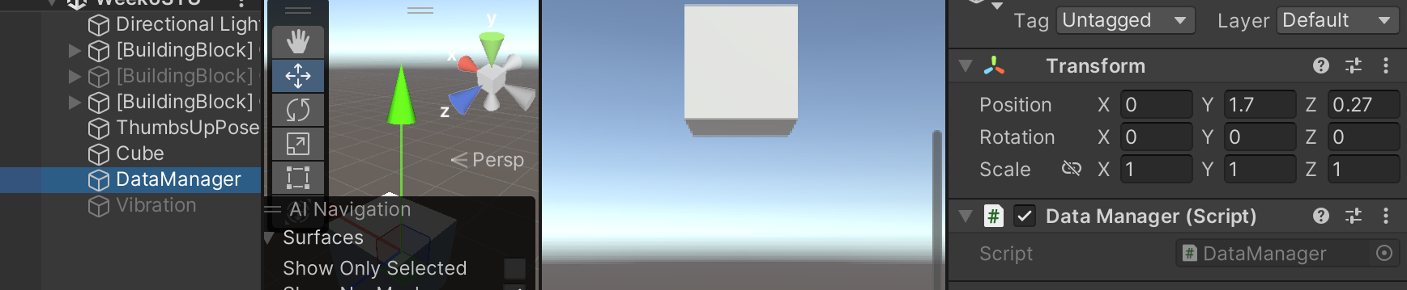
Collecting Quantitative Data In Unity - Singleton
The Singleton Pattern allows you to define classes at the global scope and directly use their methods and properties. In a nutshell, it allows you to manage and collect quantitative data centrally.
Note: There can be only one singleton for the same class in your scene.
You need to attach a singleton class to an empty GameObject
More on Singleton: Singleton Design Pattern (credit: Richard)
public class DataManager : MonoBehaviour { #region Singleton // This is how you declare a class as a singleton, meaning that only one instance of this class can exist at a time. public static DataManager Instance; #endregion // Start is called before the first frame update void Start() { // Make sure that only one instance of this class exists at a time. if (Instance == null) { Instance = this; } else { Destroy(this); } }

Slide 8
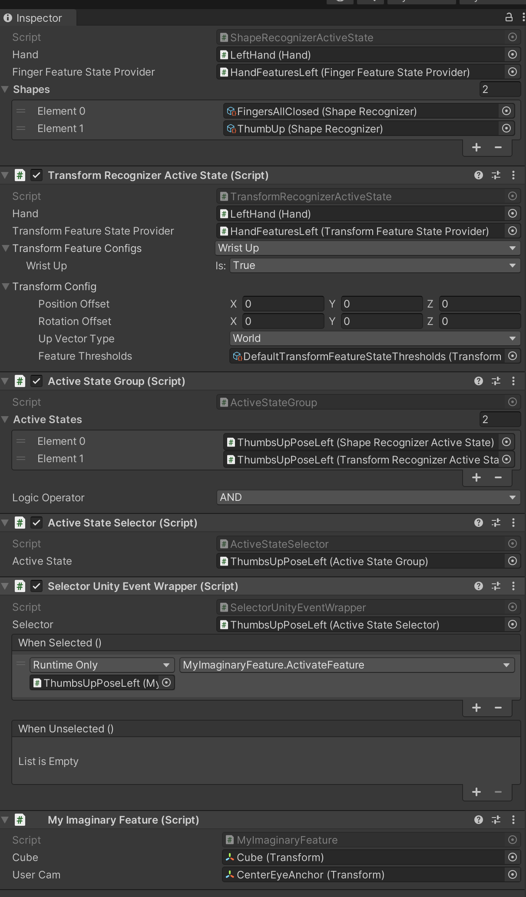
Collecting Quantitative Data In Unity - Error Rate
public class MyImaginaryFeature : MonoBehaviour { public Transform cube; public Transform userCam; public void ActivateFeature() { if (Vector3.Distance(cube.position, userCam.position) > 3f) { // Nothing happens cuz you are not within 3 metres from the cube } else { // TODO: your actual feature to be implemented here } } }
Suppose we have a feature in our prototype which can be activated when the user performs a thumb-up gesture while within 3 metres to a cube (adopted from week 6’s studio), a question to ask could be ‘how intuitive/easy it is for users to achieve the goal of activating my feature?
One way to measure this is to measure the error rate, i.e., the number of times the user (un)successfully triggers the feature divided by the total number of trials. We can use a Singleton data manager for this.
Note: this is a very simplified example but the logic for you to apply into your prototype is the same.

Slide 9
Collecting Quantitative Data In Unity - Error Rate
public class DataManager : MonoBehaviour { #region Singleton // This is how you declare a class as a singleton, meaning that only one instance of this class can exist at a time. public static DataManager Instance; #endregion public int errorCount = 0; public int totalCount = 0;
// Start is called before the first frame update void Start() { // Make sure that only one instance of this class exists at a time. if (Instance == null) { Instance = this; } else { Destroy(this); } }
}
One way to measure this is to measure the error rate, i.e., the number of times the user (un)successfully triggers the feature divided by the total number of trials. We can use a Singleton data manager for this.
You can access properties of the Singleton class from your other scripts by invoking ‘NameofSingleton.Instance.NameofProperty’
public class MyImaginaryFeature : MonoBehaviour { public Transform cube; public Transform userCam; public void ActivateFeature() { if (Vector3.Distance(cube.position, userCam.position) > 3f) { DataManager.Instance.errorCount += 1; DataManager.Instance.totalCount += 1; } else { DataManager.Instance.totalCount += 1;
// TODO: your actual feature to be implemented here } } }

Slide 10
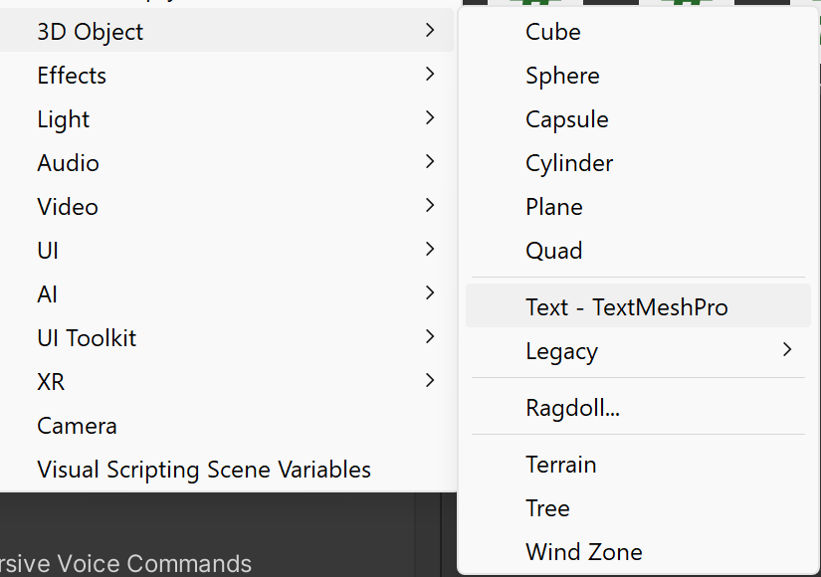
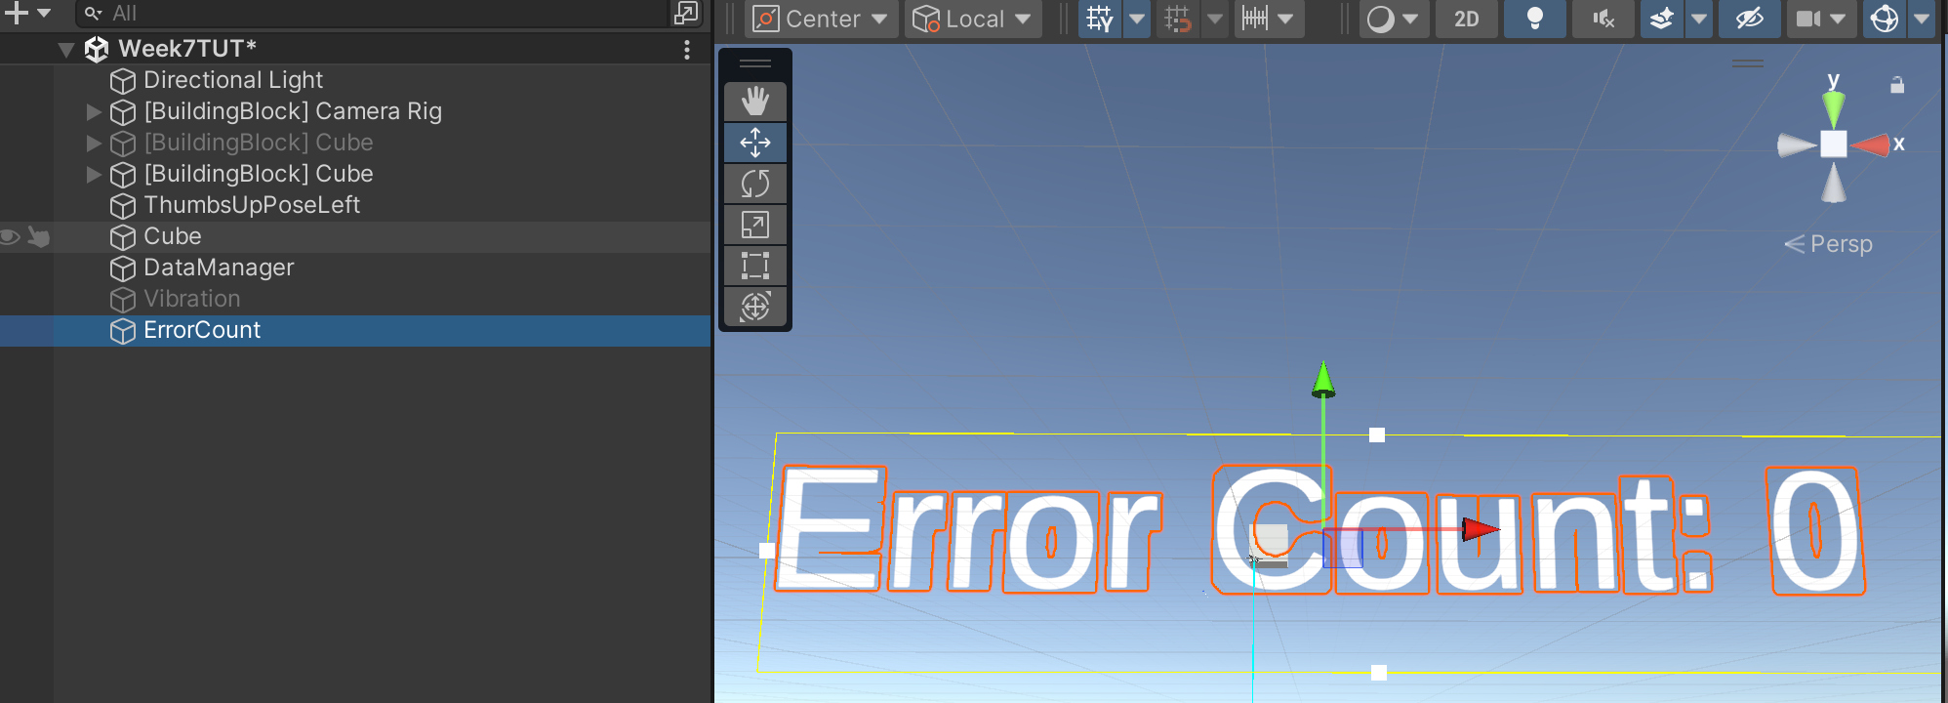
Collecting Quantitative Data In Unity - Error Rate
You can log these numbers in the scene via a Text GameObject (make sure you get a reference to its text)

Slide 11
Collecting Quantitative Data In Unity - Error Rate
public class MyImaginaryFeature : MonoBehaviour { public Transform cube; public Transform userCam; public TMP_Text errorCountText; private void Update() { errorCountText.text = “Error Count: “ + DataManager.Instance.errorCount.ToString(); } public void ActivateFeature() { if (Vector3.Distance(cube.position, userCam.position) > 3f) { DataManager.Instance.errorCount += 1; DataManager.Instance.totalCount += 1; } else { DataManager.Instance.totalCount += 1;
// TODO: your actual feature to be implemented here } } }
You can log these numbers in the scene via a Text GameObject (make sure you get a reference to its text)

Slide 12
Collecting Quantitative Data In Unity - Time on Task
public class DataManager : MonoBehaviour { #region Singleton // This is how you declare a class as a singleton, meaning that only one instance of this class can exist at a time. public static DataManager Instance; #endregion public float timeTaken = 0; // Start is called before the first frame update void Start() { // Make sure that only one instance of this class exists at a time. if (Instance == null) { Instance = this; } else { Destroy(this); } } // Update is called once per frame void Update() {
// Demonstration only, you will need to customise the code on when to start and stop timing. timeTaken += Time.deltaTime; } }
You can also apply the same trick to measure the time taken on completing a task, by summing up Time.deltaTime (the amount of time elapsed since the last frame)

Slide 13
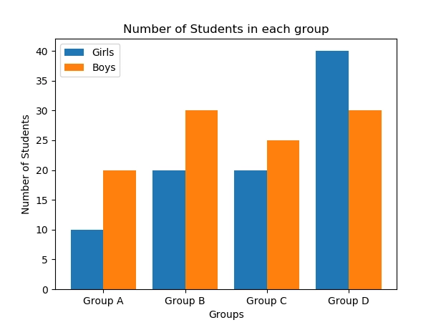
Basic Data Visualisation and Interpretation – Bar Charts
Bar charts illustrate categorical data. It makes comparing different categories trivially easy, quick, and efficient for data comparison (and decision-making).
When to use bar charts
Bar charts are especially useful for:
Visually comparing the quantities or values of different categories.
Displaying the distribution of data within sub-groups and categories.
Comparing values across a single dimension and multiple categories.
Studying the performance of different segments in your sample.
10 Data Analytics Charts: Types and Data Visualization Examples (userpilot.com)

Slide 14
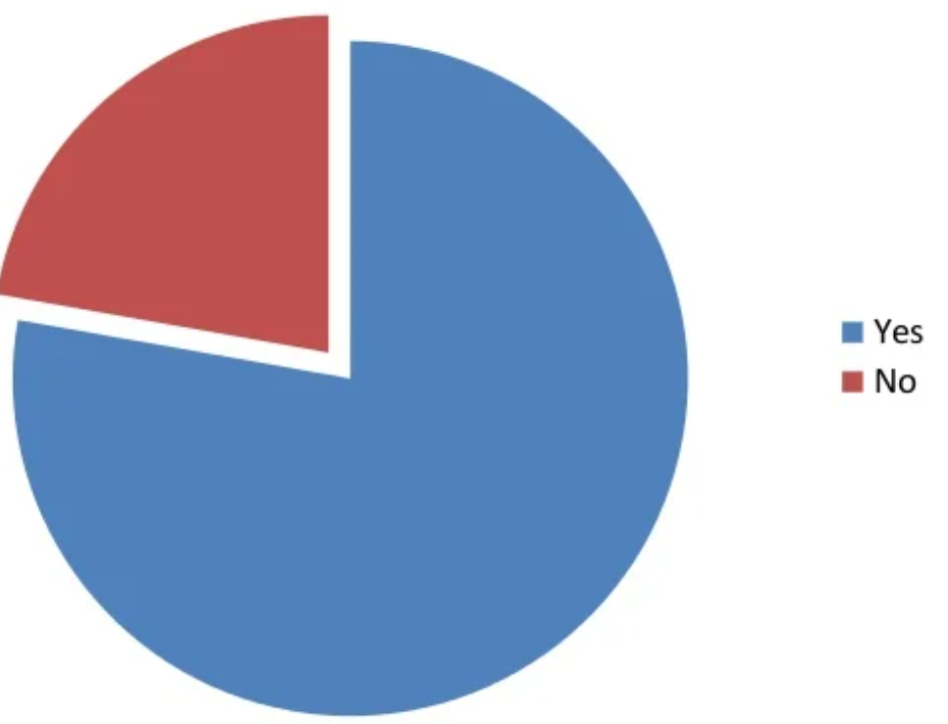
Basic Data Visualisation and Interpretation – Pie Charts
Pie charts reflect the proportional representation of different categories within a whole.
When to use pie charts
Pie charts are useful for comparing data from a handful of segments, as well as percentages. Just beware that too many slices can clutter the chart and make it hard to discern.
10 Data Analytics Charts: Types and Data Visualization Examples (userpilot.com)

Slide 15
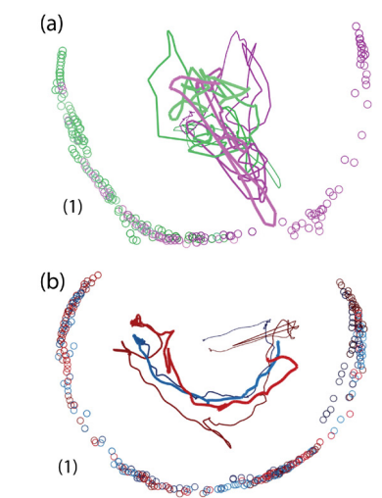
Basic Data Visualisation and Interpretation – Scatter Plots
Scatter plots show relationships between pairs of continuous variables.
When to use scatter plots
Scatter plots can be useful for revealing the changes in position of the user in Unity (e.g., along the horizontal axes X – Z).
Immersive Collaborative Analysis of Network Connectivity: CAVE-style or Head-Mounted Display? | IEEE Journals & Magazine | IEEE Xplore
How to interpret scientific & statistical graphs(vumc.org)

Slide 16
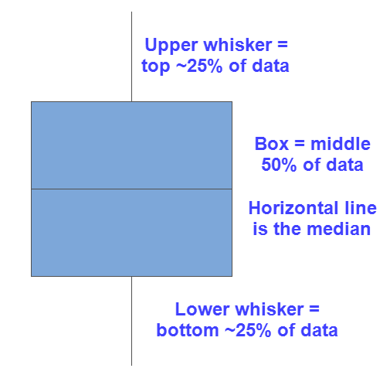
Basic Data Visualisation and Interpretation – Box Plots
A box plot provides a snapshot of your continuous variable’s distribution.
When to use box plots
Use a box plot to compare distributions when you have a categorical grouping variable and a continuous outcome variable. (E.g., Time on task)

Slide 17
In the reminder of this session
Keep working on your prototype II, keep the headset plugged in.
We will be walking around to address your questions
Please always delete your build from the headset before you go, and properly turn the headset off by long-pressing the side-button.

